Slide 1
Climate change

Slide 2
Climate change

Slide 3
South Sudan

Slide 4
Our children and grandchildren
‘The year 2050 – when the impacts of climate change will be strongly felt – may seem like the distant future for politicians, but it’s our children’s future and they have a right to have it protected.’ Save the Children

Slide 5
‘The predicted extent of climate change is a novel moral problem. … Most people in British Empire did not own slaves, even though an important proportion of the wealth of the Empire was built on the profits from slave labour plantations.
But every individual who has driven a car, or flown in an aeroplane, lived in an energy hungry modern house, bought clothes or computers made 10,000 miles away, or bought shares in a large corporation, is fractionally involved in global warming.’ Michael Northcott

Slide 6
Social transformation
Personal
Local
Glocal
Generational
Global

Slide 7
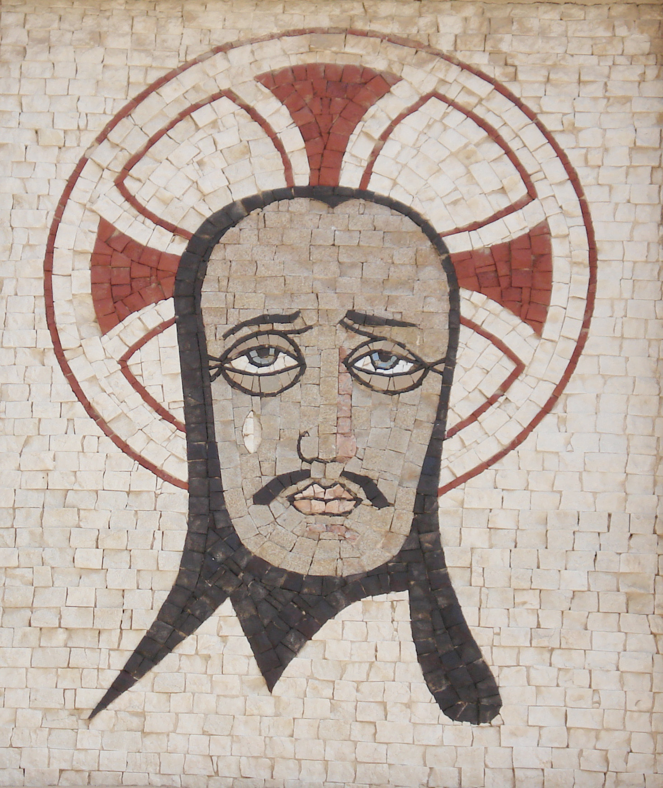
Social transformation
Personal
Local
Glocal
Generational
Global
In
made new
things
all
Him

Slide 8
The church participates in God’s transformation of the world
By what it hopes for
By what it is
By what it prays
By what it does

