Slide 1
What do you see?
The following 2 pictures are focused on the theme of Hope. Use the questions to help you reflect on different emotions, values and Bible verses. You may like to look at the pictures as part of a class worship.

Slide 2
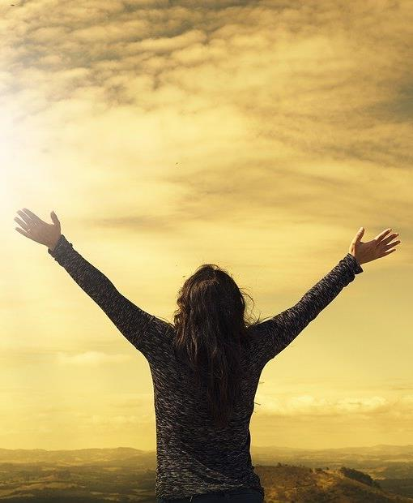
Look very carefully at each picture – the first one is on the next slide.
Click again and you will see a list of questions on the following slide.
There is no need to write your answers down, you can just think or talk about them
There is not just one answer. Listen carefully to other people’s views.

Slide 3
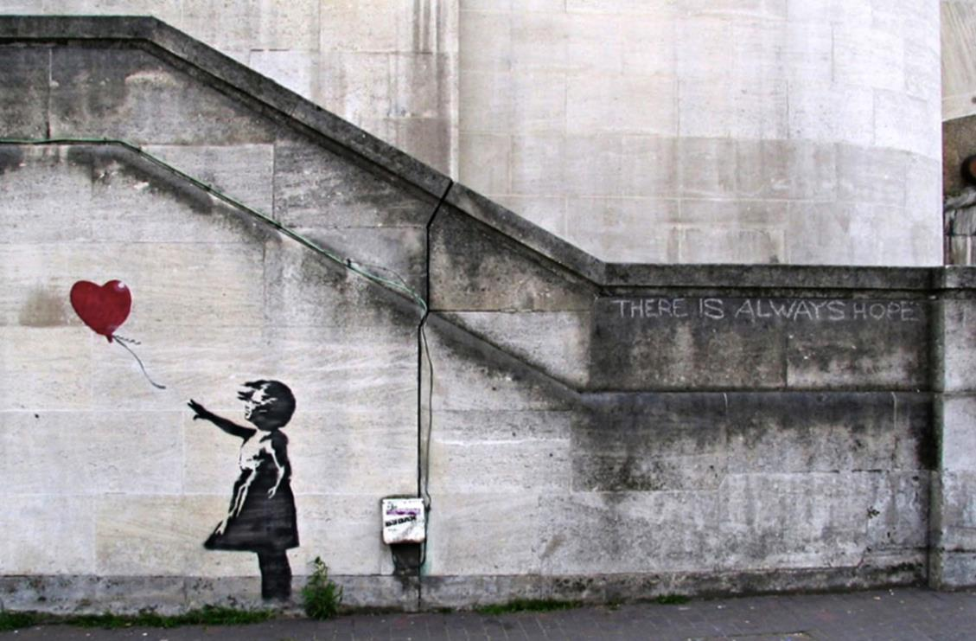

Slide 4
Challenge 1
Many years ago a real girl held a real balloon, releasing it into the sky as she hoped her prayers would be answered. Now, her picture is drawn on the walls behind the place where she once stood.
In a world where sometimes times were sad, lonely or perhaps scary and dark, the flash of red brought colour. In a world where things are sometimes bleak, it brings hope and joy. The girl’s outstretched fingers point at the red balloon as it floats skywards.
Question time
Why do you think the balloon is red, whereas the rest of the drawing is black and white?
Who is the little girl, and why is she releasing the balloon?
What could have happened to her? Do you think the balloon symbolises anything?
Why do you think the artist created this picture?
What has this picture got to do with hope?
The Bible has quite a lot to say about hope. The word hope in everyday life often refers to a kind of wish. For instance, “I hope it will not rain tomorrow” or “Let’s hope she gets better soon.”
Hope in the Bible is about having complete faith in God. Therefore, biblical hope is something real and not a feeling. Biblical hope is the foundation upon which Christians base their lives, believing that God always keeps His promises.
Do you think that Biblical hope is stronger than everyday hope?
Is it harder or easier t have Biblical hope?
Perfect picture!
Can you design a piece of art to show that there is always hope in God?

Slide 5
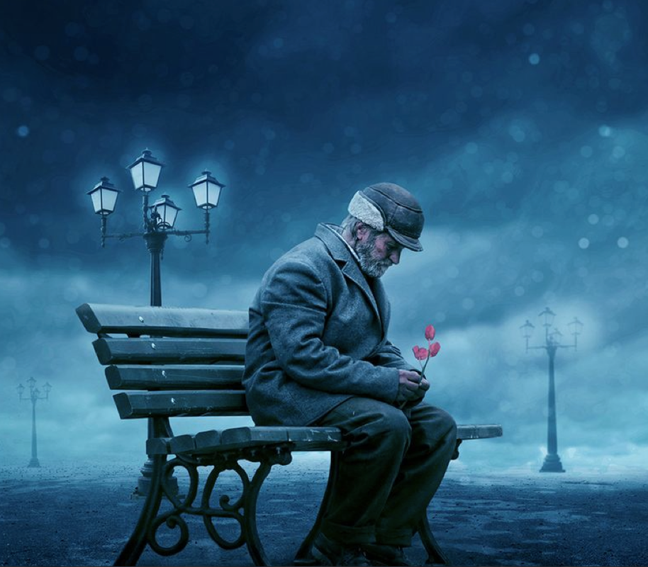

Slide 6
Challenge 2
The flowers gave him hope.
Sitting there in the frost-covered park, with snowflakes gently falling from the cold, October sky, he thought about the events of the past few days. Despite everything, he still had hope for the future.
Question time
Who is the man in the park? What has happened to him?
What do you think he is hoping for? What is significant about the flowers?
What colour is winter? What colour is summer?
Is there more happiness or sadness in the world?
In challenge 1 we looked at Biblical hope – hope that many Christians say leaves them with no doubt that God will care for them and make things better.
Read the Bible story on the next page and then reflect on the questions………

Slide 7
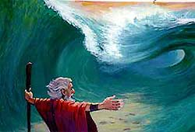
The Parting of the Sea
Pharaoh gathered all the chariots in Egypt to chase after the Israelites and bring them back as slaves. Even Pharaoh mounted his chariot and set out for the Israelite camp.
From far away, the Israelites could see Pharaoh and his army coming for them. They were terrified and cried out God to save them. They turned to Moses and said, “Have you brought us here to die in the wilderness? What have you done to us? It would have been better for us to stay as slaves in Egypt than die out here alone!”
Moses said to the people, “Do not be afraid. Stand firm and see what the Lord will do for you today. He will fight for you. Just keep still.” Then God said to Moses, “Why do you cry out to me? Lift up your staff, and stretch out your hand over the sea to divide it. Tell the Israelites to go forward and walk through the middle of the sea. The Egyptians will follow and know that I am the Lord.”
Then an angel of God appeared to lead them across the sea. A cloud formed between the Egyptians and the Israelites. Moses stretched out his hand, and a strong wind created a path of dry land through the sea, with walls of water on both sides. The Israelites travelled through the sea safely to the other side. The Egyptians followed them through the parted waters, but the wheels of their chariots became clogged in the mud. Moses stretched out his hand again so that the water would crash over the Egyptians. The Israelites saw the great work of God and how he saved them from the Egyptians. They saw this and believed in the Lord with certain hope for the future.
Reflection Questions
What complaint did the Israelites make to Moses?
How did God save them from the Egyptians?
What are you most afraid of right now? How can you ask God
to help you overcome this fear?

