Slide 3
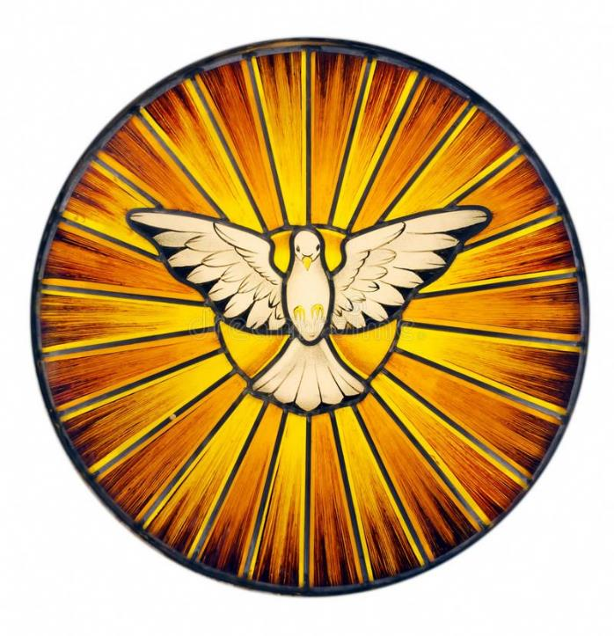

Slide 4
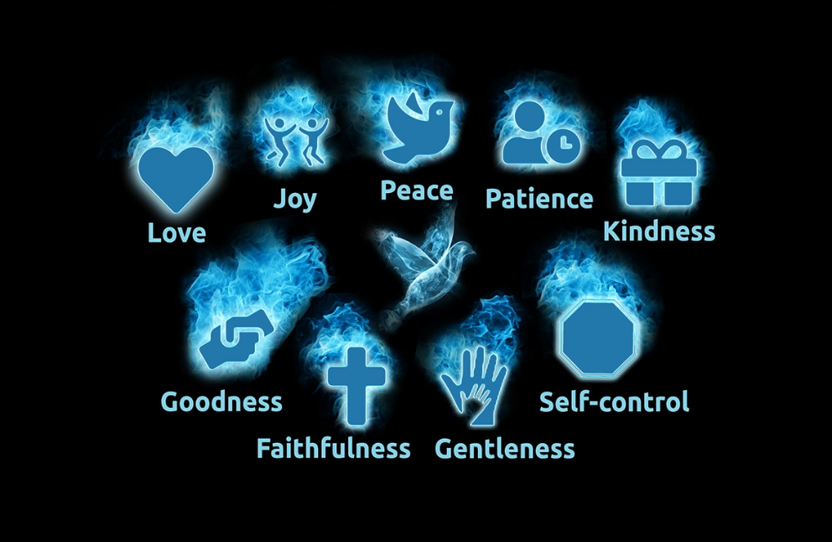

Slide 5
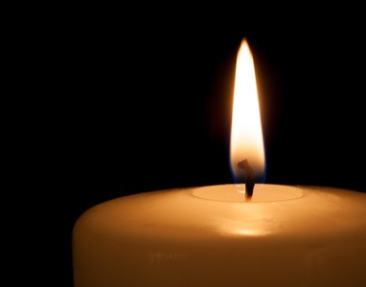
Heavenly Father
Thank you for the gift of the Holy Spirit that can dwell in us.
We pray that your spirit will guide us in the ways of love and fellowship with each other and lead us in the ways of goodness, kindness and forgiveness.
Amen

