Slide 1
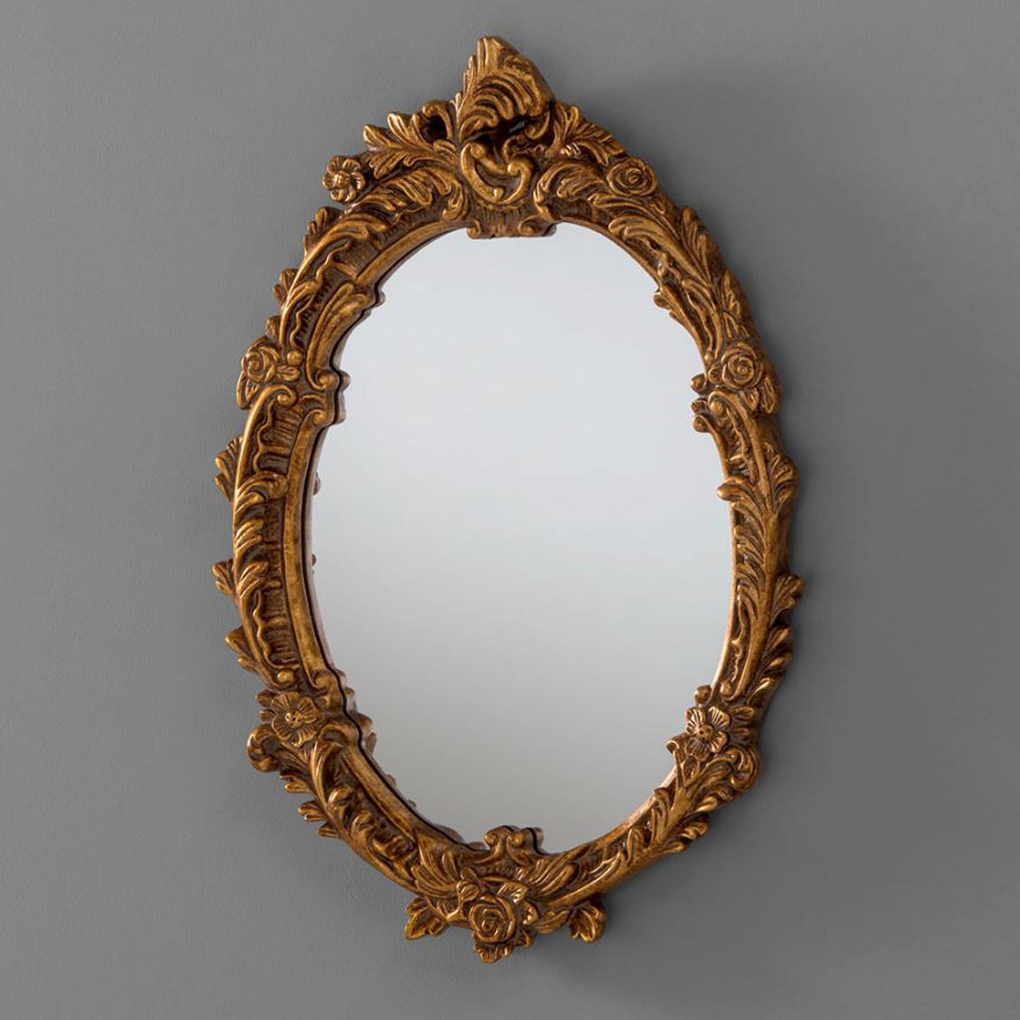
‘Mirror moments’
How long do you spend in front of the mirror?!
How about a different type of reflection……
How much time do you think about who you are and what is special about you?

Slide 2
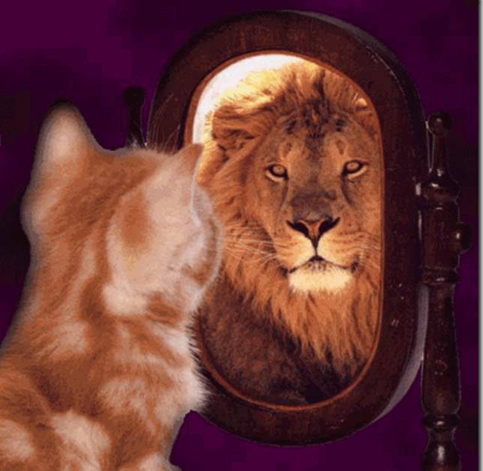
…..or do we spend too much time thinking about how we wish we were different?

Slide 3
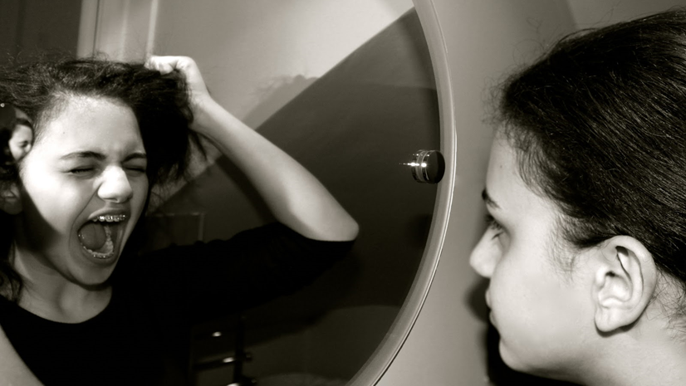
….or do we hide how we feel about ourselves from others by not talking about it?

Slide 4
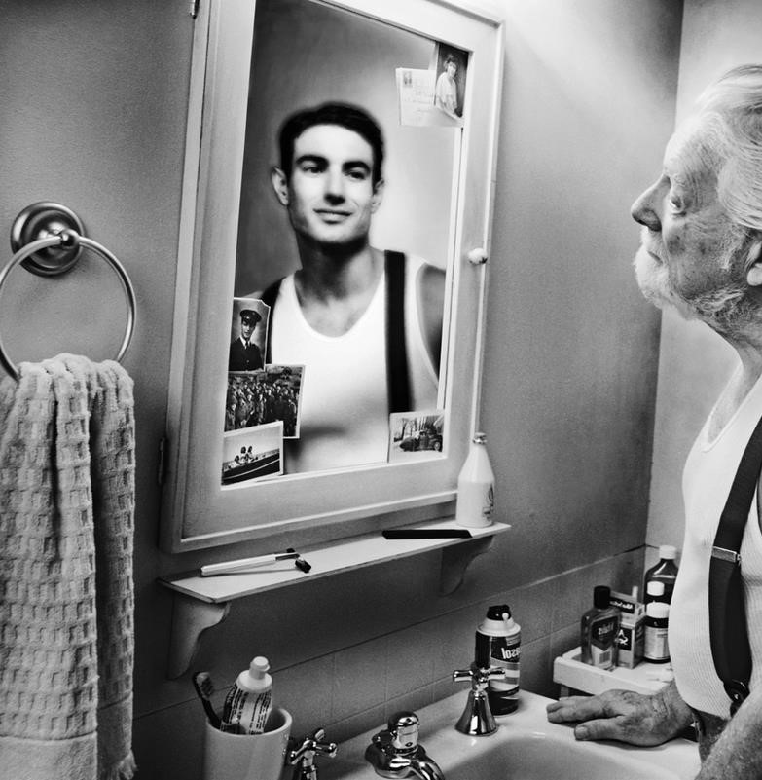
Perhaps we spend a lot of time thinking about what we were like in the past?

Slide 5
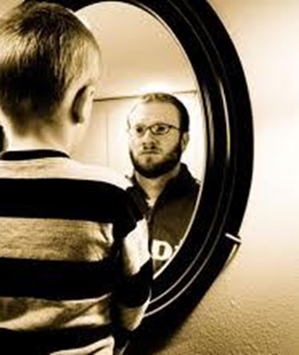
…..or about what we hope to be like in the future?

Slide 6
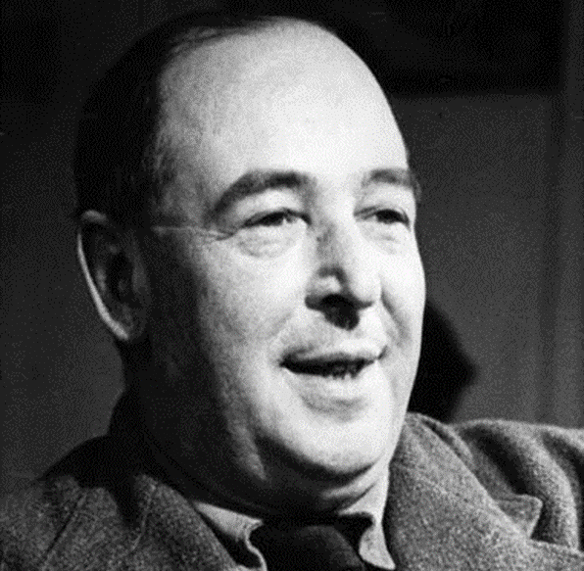
The famous author CS Lewis said, ‘Though our feelings come and go, God’s love for us does not’.
Christians believe that we can all experience God’s love all the time. We may have feelings about ourselves and others that change from time to time, but in God’s eyes we are all special and unique creations worthy of his love.
Remember – you are unique and special!

Slide 7
Dear Lord We thank you for making us the way we are and giving every one of us unique qualities. We ask you to help us in our weaknesses and to stand by our side to face our fears. Be with us in our happiness and joy and help us to help others know that they are special too. In Jesus’ Name Amen

