Slide 1

Ubuntu Drumming for Schools & 2023 Leavers Services Guidance
Please share this presentation with your children. Click the audio button in the top righthand corner of each slide.

Slide 2





Slide 3
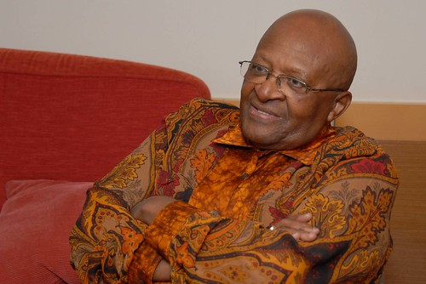


Slide 4
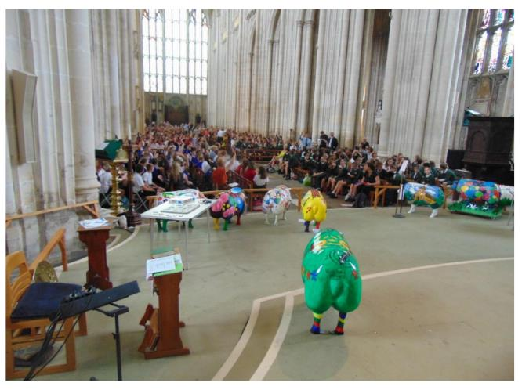
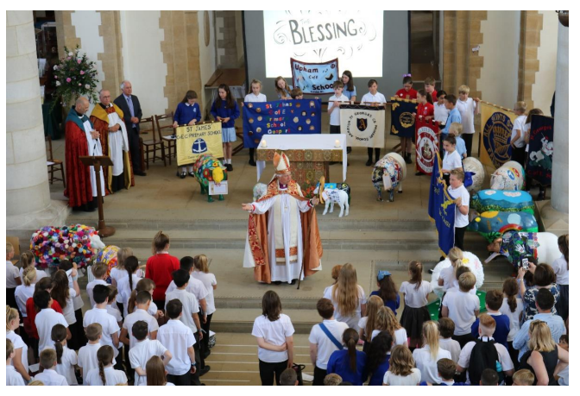
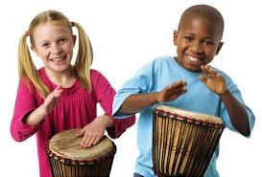

Slide 5

Click the link to watch Mike showing how you can create a rhythm ready for our special performance.
https://youtu.be/bi4kfNxtEFM
You might also use the video to create your own music in school.

Slide 6
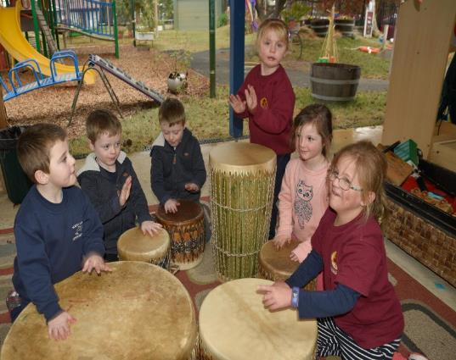
Create a simple, short rhythm for your school.
Think of a few words or a short phrase that sums up your school, for example, ‘We have fun and help our community’ or ‘Our school is like a family’. Then set this phrase to a rhythm, like Mike demonstrates in the video. Don’t make it too long, just a few notes.
Make sure that everyone who is coming to the service knows the rhythm because you will need to perform it during our special Ubuntu musical performance.
If you have any drums in school, it would be great if you can bring them.

Slide 7
Drums – a worthwhile investment
There is no requirement for schools to purchase instruments to participate in the worship and creative music-making at the Cathedrals.
Many schools use drums for a range of activities – including supporting Mental Wellbeing, Group Work, Performing Poetry, Reciting Psalms, Participative Story-telling and much more – so they are a great investment.
Schools are invited to bring drums to the services if they wish, but rhythms can also be played using body percussion.
Some examples available from online sellers:
World rhythm HD6 Hand Drum with beater £8
JOIKIT 3 pack Hand Drum set £17
Lawei 2 pack Hand Drums £13
Children’s African Djembe Drums £12

