Slide 1
https://www.youtube.com/watch?v=S1foLsxjinU
Notes:
Please familiarise yourself with the information in the accompanying Epiphany Notes before leading this worship.
Use the ‘epic’ version of ‘We Three Kings’ at the above link as gathering music (it is the tune set to a ‘Game of Thrones’-style orchestral arrangement).

Slide 2
Notes:
Begin the worship by lighting a candle and/or following the school’s usual gathering routine (substitute the above image with your usual school prayer or other ‘gathering image’ that you normally use as appropriate).
Ask the children whether they recognised the tune that was playing as they gathered for worship.
Ask the children whether anyone can think of why we might have been listening to that tune now that Christmas is over.
If you follow the liturgical colours, you could also ask them why our colour is still white/gold now that Christmas is over.

Slide 3
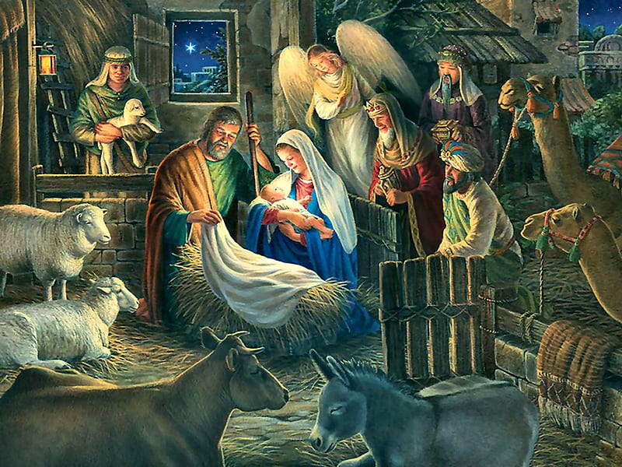
Notes:
Either use the above image or (preferably) you could get the children from the school nativity before Christmas to dress up in their costumes and form a nativity scene at the front.
Ask some of the younger children to explain who the different people are in the scene.
Explain to the children that the visit of the shepherds and the visit of the kings to baby Jesus are really two separate stories in the Bible but when we tell the story at Christmas, we often put them together so that all of the people can be in the scene at once.
A couple of things to note: the Bible actually refers to magicians or ‘magi’ rather than ‘kings’ or ‘wise men’ and the Bible doesn’t actually say that there were three of them, we infer the number three from the three gifts that the Bible tells us they brought. You may wish to use your judgement about which term (magi, wise men or kings) will be most helpful to use with the children.

Slide 4
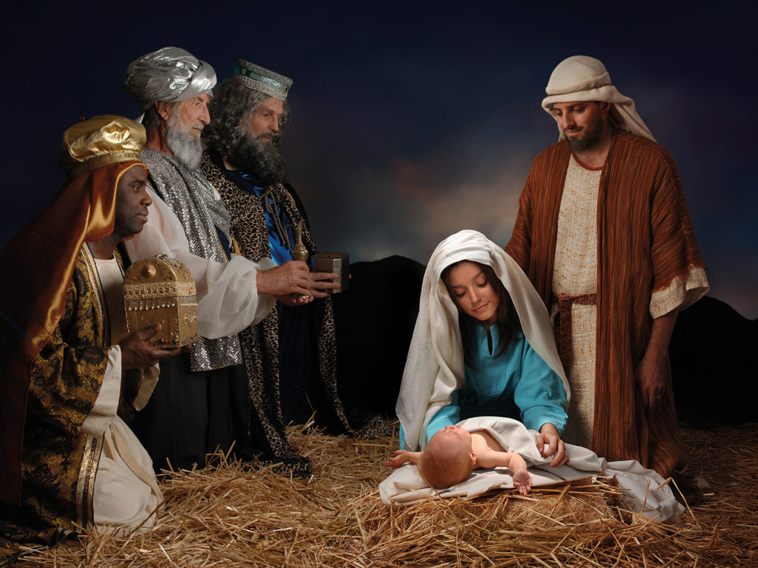
Notes:
Explain that in the story in the Bible, the visit of the kings (or Magi) happened some time after Jesus had been born and the shepherds and the angel had gone away – so the real scene might have looked more like this. If you have been able to gather the children in their costumes, you could act this out with them…

Slide 5
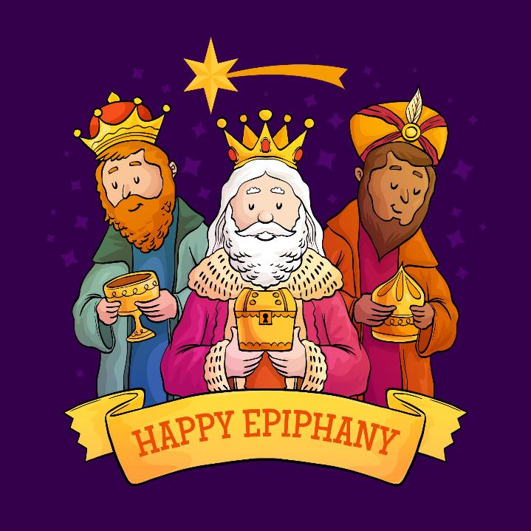
Notes:
Explain that the special day on which the kings (or magi) visited is known as the Feast of the Epiphany and it is always on the 6th of January (the twelfth day of Christmas). Explain the following in your own words:
The story of Epiphany helps us to understand that Jesus was a new kind of king for all people. The magi had come from distant countries and they thought that they had come to pay homage to a new all-powerful king. But what they found was a very poor baby lying in a manger. In that moment of ‘epiphany’ (epiphany means a sudden realisation) they realised that what truly matters to God is not what they thought. Here is a ‘king’ who is to be found in the humblest of circumstances, who rules in the hearts of all people and is present where we least expect; whose power is the power of love. It is this realisation that is the ‘epiphany moment’ – and it is good News for the whole world.

Slide 6
Notes:
Discuss the following in your own words:
Because Jesus came to show us a new way to live in appreciation of all of the things that we take for granted, that’s why we value learning so much – we want to find the wonders of God’s creation in the world. Every small discovery that we make is a moment of epiphany because it represents God revealing the wonders of creation for all people to appreciate. God wants us to learn the lesson of the magi - that it is in stopping to think, reflect and care for the things we take for granted that we find true meaning.

Slide 7
Notes:
Invite children to reflect on whether there are sometimes things that they take for granted. Are there times when they don’t always appreciate the simple things in the world around them? Are any children able to share any ‘epiphany moments’, when they have seen something knew that they hadn’t realized before?

Slide 8
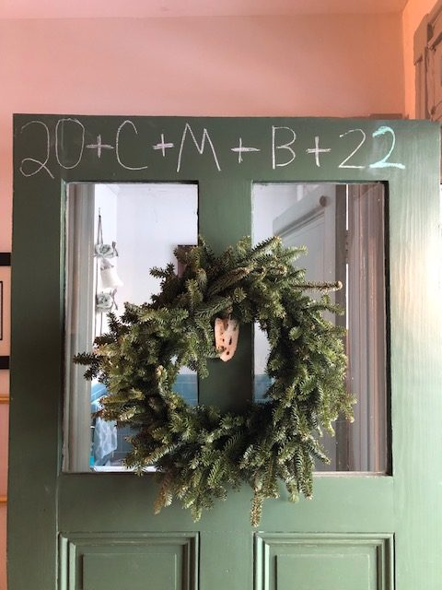
Notes:
Ask the children whether they can guess why this door has a special code written on the top of it.
Explain the Epiphany tradition of ‘chalking the doors’. This is explained fully in the accompanying notes.
Chalk the doorway to the hall to illustrate this, using the words and procedure from the notes. If this isn’t practical, make a strip of black sugar paper and chalk this so that it can be stuck above the door later (see the picture in the next slide).

Slide 9
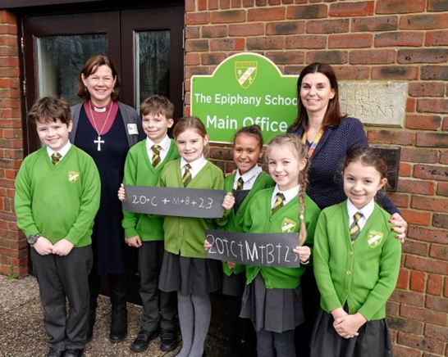
Notes:
Send the children out by telling them that you have asked all of their teachers to lead them in chalking their classroom doors together. (You could do this by sticking up a strip of paper as in the picture or chalking the brickwork about the doors if your classrooms have outside doors).
If your vicar is available to be involved, an added part of this tradition is for your vicar to bless a basket of chalks before giving them out to use for the purpose.
As a further optional activity, you could send the children home with a piece of chalk and a note with the instructions so that they can chalk their door at home.

Slide 10
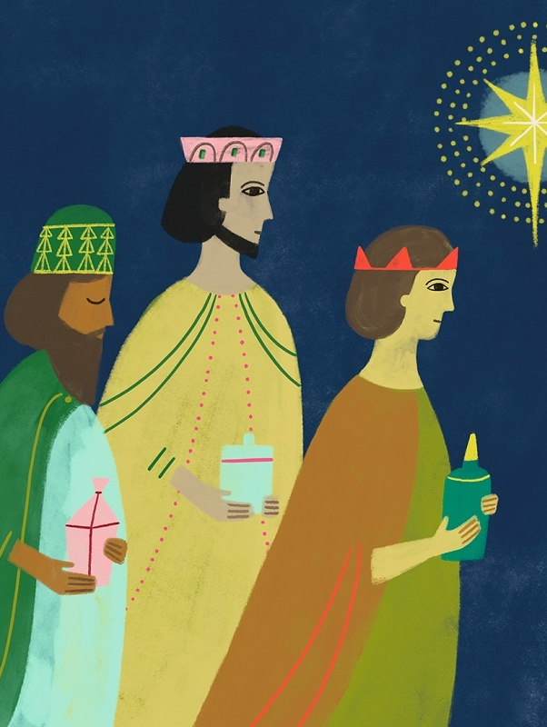
Dear God, bless our school and our learning this year, that in our classes we may find epiphany and friendship, courage and forgiveness, through Jesus Christ. Amen
Notes:
Finish with this prayer.

Slide 11
https://www.youtube.com/watch?v=cFgByOyX-FQ
Notes:
Children will enjoy the version of ‘We Three Kings’ at the above link – it is a hip-hop version from The Star (an animated film version of the nativity story from 2017)

