Slide 1





Doubling the number of children and
young active disciples in the Church of England by 2030

Slide 2
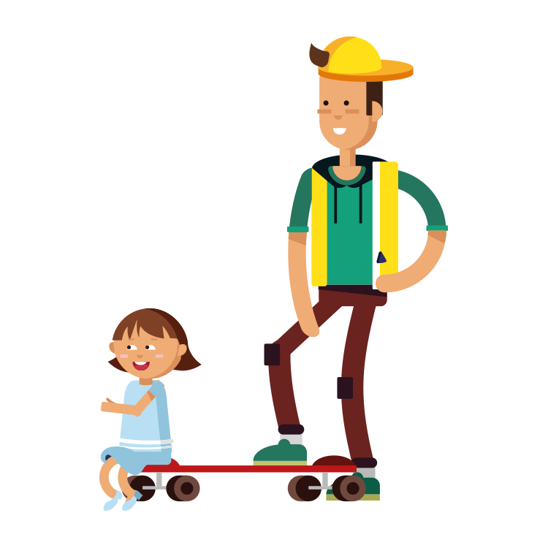
Doubling the number of children and young active disciples in the Church of England by 2030

Slide 3
Winchester <18 Worshipping community
• In 2019 had a <18 WC of 4700 therefore to
double it is 9400 by 2030
• In 2021 3500
• In 2022 3300
• Therefore to reach 9400 by 2030 = x 2.95
• In 2022 Winchester has 15 churches with
>25 awa and 42 with 15-14 awa

Slide 4
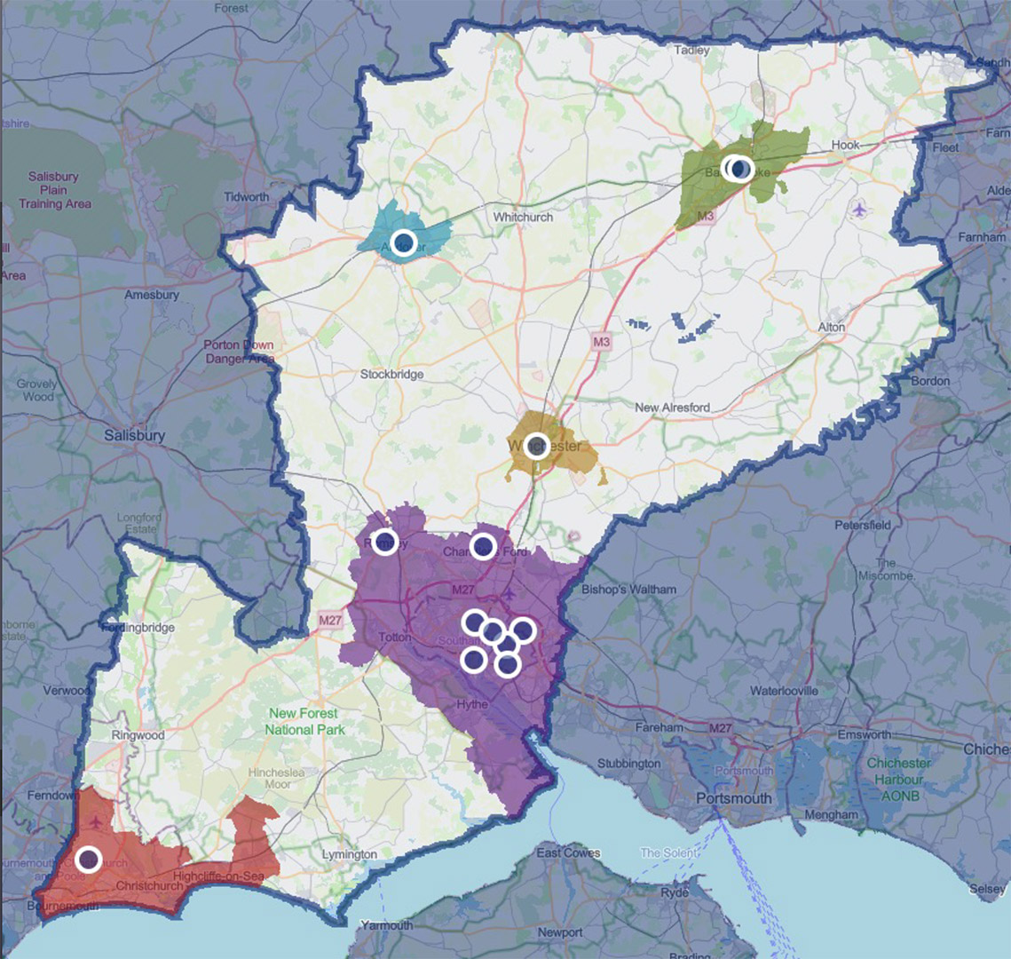
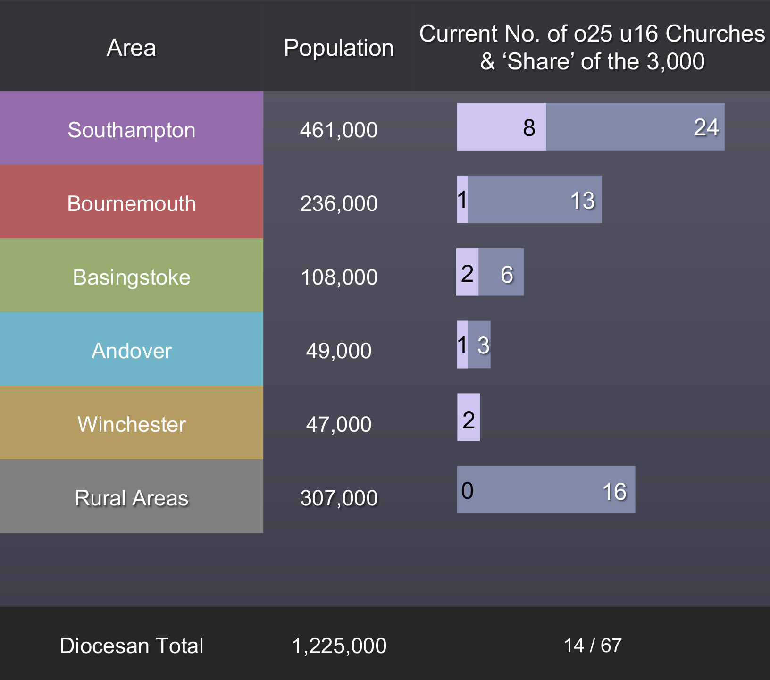

Winchester and the 3000 churches

Slide 5
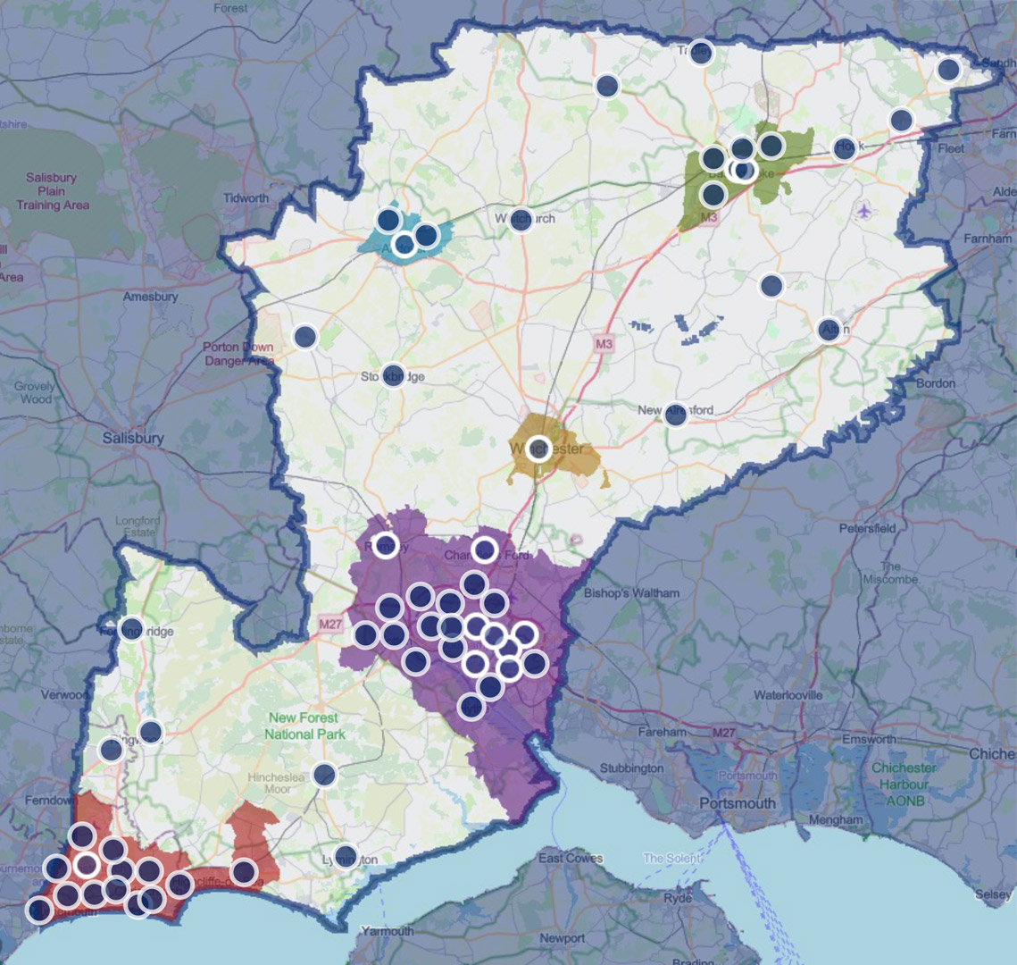
Winchester and the 3000 churches
What would a Winchester with its full share of the 3,000 look like?
Assuming every context got to the number on the previous slide (and with locations randomly chosen within each context)…
There would be a wealth flourishing churches with large numbers of u25, ensuring that all children in the diocese were within reach of a thriving youth ministry.

Slide 6
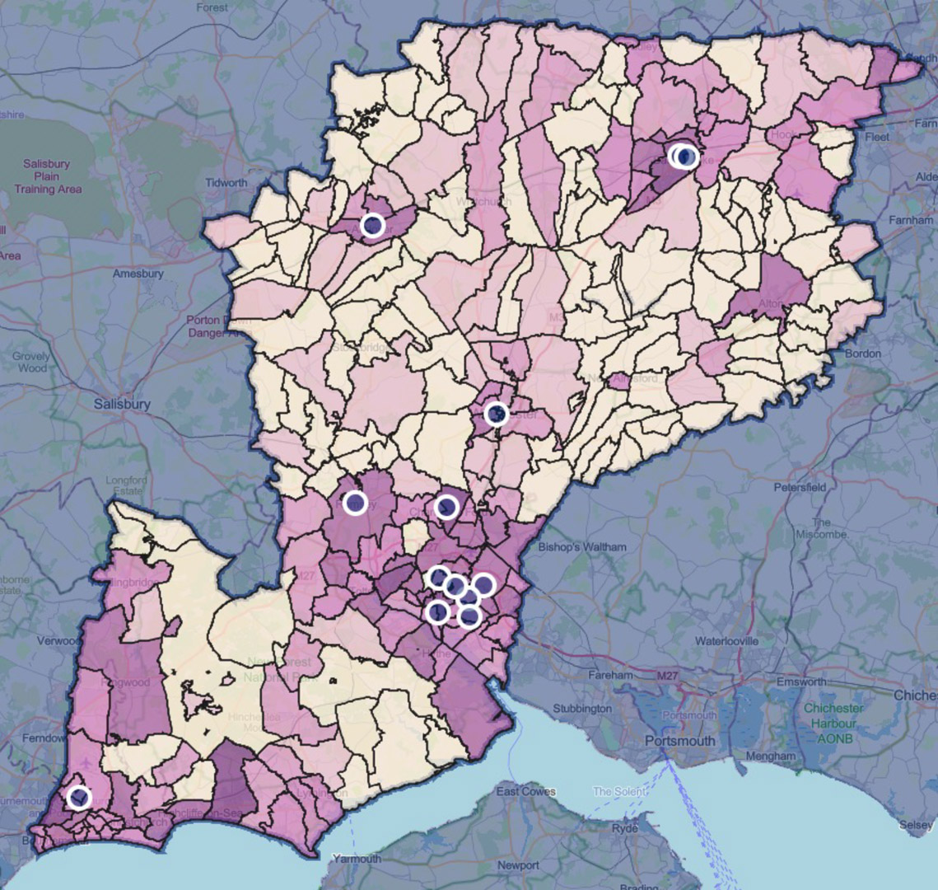
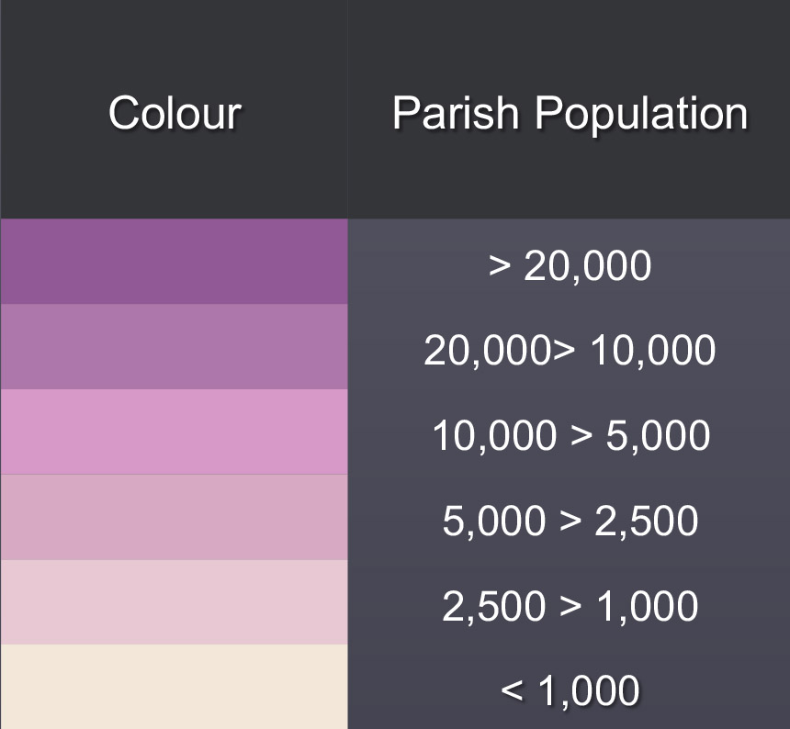
Winchester and the 3000 churches
In theory, every dark coloured parish is large enough to have one such church in it – and there should be one such church for every 3-4 lighter coloured parishes, depending on population size.

Slide 7

Prioritise
Resource
Adapt
You

Slide 8
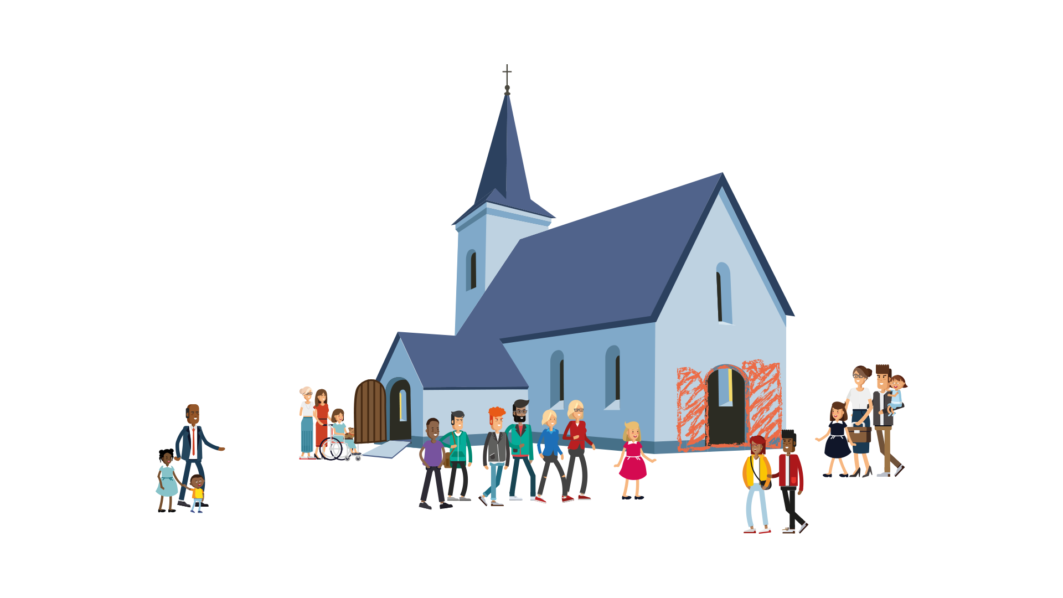
Questions
What are the key lessons that you have learnt throughout your ministry about CYP?
What are you currently doing?
What would you love to see happen in your church?
What are the blockers and what are the opportunities?

Slide 9

Schools
Build on assemblies by offering other things, not just lunchtime clubs. Possibly consider after school clubs or building on some of the year six seven transition, this may require permission from the school and governing body.
Don’t underestimate the power of signpost to things that happen in the church for children, young people and families and regularly invite. These are spaces where what they have heard in school can be built on and developed.
‘Flourish’ could be a really good way of developing faith in schools as it will be pupil/ student led. Pupil chaplains are also a way of developing faith in schools with clergy, chaplains and others supporting the pupils (ask Mike Haslam more about this).
Clergy can help pupils to develop faith by helping them to grow in confidence and developing skills to share their faith with others. This can be done in a small group setting in school time.
Many clergy are not well equipped for developing faith and discipleship in a school context, so they will benefit from training. They will also benefit by regular involvement in the youth/children’s ministry in their church. To grow and develop faith on the coalface clergy need to experience being in the coalface with children/young people on a regular basis.
Make sure the vicar knows the termly RE syllabus being used in their local school so they can join in with it and look for opportunities to grow and develop faith.

Slide 10

Schools
Be creative by using a variety of up-to-date tools and resources, what used to work probably won’t work anymore. So clergy be prepared to venture where they may not have before.
Find out what matters to the children, such as the environment and justice, and help to develop faith around what matters to the children.
Share the responsibility of developing faith and discipleship with others in the church. This will help continuity if the clergy move on. it will also show that being a Christian and developing faith is not just the vicar’s job.
Pray for the school regularly in PCC meetings, church services and other gatherings.
Develop faith with the whole school community, if staff parents and children develop in faith together, it will grow faith across the whole community and beyond.
Focus on growing faith in the household so families grow in faith together. This is truly building on the vision behind Growing Faith, as it will affect church, school, and household.

Slide 11

Questions
Where do you see the potential here for your church/deanery
Mapping out what this would look like
How could you
    Pray intentionally
    Prioritise
    Resource
    Adapt
    You in your church?

Slide 12
Winchester and the 3000 churches
In theory, every dark coloured parish is large enough to have one such church in it – and there should be one such church for every 3-4 lighter coloured parishes, depending on population size.

