Slide 1


DIGITAL PROMO PLANNER 2023

Slide 2




DIGITAL PROMO PLANNER 2023
Overview
WHAT IS THE DIGITAL PROMO PLANNER?
HOW TO USE IT
HOW TO GET STARTED
This digital promo planner has been created to support you to make the most of digital platforms to promote your services and events in the lead-up to Advent and Christmas.
Find out everything you need to know about Follow the Star: Join the Song here
  As a template to create your own planner
  As a guide to plan your different promotion activities before, during and after your services and events
  Edit the templates simply in PowerPoint or in Canva
  Use the empty sections for your own planning
  Decide on the different services and events you are going to host
  Have a think about the different people you want to reach: try and define them in as much detail as possible. You know your community best!
  Make sure you have an idea of which channels you want to use
  Plan and schedule your content in advance

Slide 3


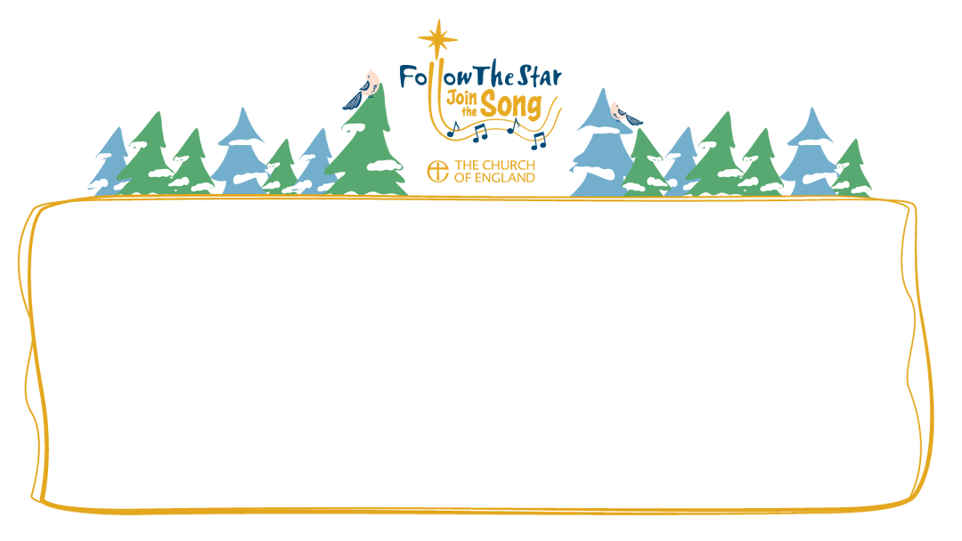

What can you create?
  Use the templates as social media and website banners
  Create social media content using the graphics generator or the Canva templates
  Re-share content that is being posted on the national channels

Slide 4
Reminder:
Use goals your church currently has and find ways you can meet them during this Christmas period
Before you start
Goals (Add your own in the empty sections) | Tips and ideas
Example: To reach more young adults in our local community who are experiencing loneliness | Where are young adults in your local community spending most of their time? How can we make them feel welcome? What type of content will engage them?

Slide 5
Before you start
THREE KEY AUDIENCES WE WANT TO REACH ONLINE THIS ADVENT AND CHRISTMAS
Audience Type | Who are they: age, gender, interests? Where do they spend their time? | Why is it important for you to reach them?
Example: To reach more young adults in our local community who are experiencing loneliness | Example: Where are young adults in your local community spending most of their time? How can we make them feel welcome? What type of content will engage them? | In our church we are trying to reach 1,000 young people by 2025. This will help us to meet that goal.

Slide 6
Before you start
Top Tip: Map out your content before you get started, when and were you will post it - even if you haven’t created it yet. This will allow you to see what content to create and post with ease.
We recommend: Schedule 30mins at the start of each week to review what content is coming up this week and then make a plan for content for the following. Only do what is suitable for you and your available resources.
EXAMPLE WEEKLY TEMPLATE
Platform | Type | Monday | Tuesday | Wednesday | Thursday | Friday
Facebook pages and groups | Image, post, live streaming and story | Image or video with caption & link. Promote event flyer. |  | Re-share posts and national content on stories. |  | Image or video with caption & link. Ask a question, Share a fun fact, Share the carol of the week.
Instagram | Image, posts, reels and stories | Image or video with caption & link. Promote event flyer. |  | Re-share posts and national content on stories. |  | Image or video with caption & link. Share a fun fact, Share the carol of the week.
TikTok, Youtube, Twitter, Threads | Tik Tok Stories, Youtube Shorts, Live stream | Upload same content as above. |  |  |  | Live stream interviewing our Vicar on what to expect. Share a fun fact, Share the carol of the week.

Slide 7
Before you start
Reminder:
You can edit this and adapt it to make it fit your needs. You can also map out your images & captions.
WEEKLY PLANNER TEMPLATE
 | Mon | Tue | Wed | Thu | Fri | Sat | Sun
Facebook
Instagram
Twitter
Newsletter
AChurchNearYou.com

Slide 8
DIGITAL PROMO PLANNER 2023
Reminder:
  If you have the event listed on multiple channels, make sure that you have a plan to monitor who is signing up.
Example: eight weeks to go
Suggested activity | Tips and ideas | Useful links
Add your services and events to ACNY, your own website and also consider listing them on social media platforms such as Facebook and Instagram. | Make sure the title and description for your event are clear, inviting and have been read by a non-Christian friend so they can offer feedback Make sure that all information is correct - for example dates, times and locations. Share your events in your newsletter and make sure you have event flyers to go with them | How to Add, tag and edit services or events

Slide 9
DIGITAL PROMO PLANNER 2023
Seven weeks to go
Suggested activity | Tips and ideas | Useful links
Share an image from a similar event in a previous year on your church’s Facebook page, share an Instagram post and include a link to this year’s event. To go the extra mile you can even ask a few members of your congregation to share what they thought of your previous events, encouraging them to then invite others to this year’s events. | Ask a question in the post to encourage engagement with the post, for example, ‘What’s the most exciting thing about the Christmas season?’ Make sure that you re-share your posts onto your Stories so that people who might not see your post might view it on Stories instead. | Five digital ideas for inviting your community to church this Advent and Christmas Graphic design tips for churches

Slide 10
DIGITAL PROMO PLANNER 2023
Template I Date:
Our activities | Platforms | Notes

Slide 11
DIGITAL PROMO PLANNER 2023
Six weeks to go
Suggested activity | Tips and ideas | Useful links
Share a link to your event in a local community Facebook group, page or WhatsApp group, saying that everyone is welcome. | Ask people in your church to share the event with their friends or groups on Facebook or WhatsApp. You can re-use your event flyer image to share across these platforms, on Stories and always make sure you add the link to the event. To go the extra mile you can add a QR code to your images to allow people to access the link quicker. | Show your church is ready to welcome this Christmas: Join in on social media Take inspiration from last year’s campaign, The Great Invitation

Slide 12
DIGITAL PROMO PLANNER 2023
Template I Date:
Our activities | Platforms | Notes

Slide 13
DIGITAL PROMO PLANNER 2023
Five weeks to go
Suggested activity | Tips and ideas | Useful links
Go to the Resource Hub on AChurchNearYou.com and use the easy graphic or video generator to make an event promo, and post this to your social media with some invitational text. | Ask people in your church to share the event with their friends or groups on Facebook or WhatsApp. You can share information about your event or share a Bible verse, carol lyrics quiz and anything that you think your audience will be interested in - which will also link to you inviting them to your events and services. | Using the Resource Hub Custom graphic and video generator

Slide 14
DIGITAL PROMO PLANNER 2023
Template I Date:
Our activities | Platforms | Notes

Slide 15
DIGITAL PROMO PLANNER 2023
Four weeks to go
Suggested activity | Tips and ideas | Useful links
Take and share pictures of your church building being decorated for Christmas. Include the volunteers (with their permission). | Use the campaign hashtags #FollowTheStar & #JoinTheSong and any local hashtags such as #Corby, and tag your local diocese. | How to add a location to a post Popular hashtags from last year

Slide 16
DIGITAL PROMO PLANNER 2023
Template I Date:
Our activities | Platforms | Notes

Slide 17
DIGITAL PROMO PLANNER 2023
Three weeks to go
Suggested activity | Tips and ideas | Useful links
Share a ‘poll’ post related to the event e.g. ‘What carol are you hoping you’ll hear at our carol service?’ Or, just ask your question in a normal text or video post, asking people to share their answers in the comments. | Line up a few people in advance who are happy to look out for the poll and complete it early, to encourage others to also take part. Make another post sharing the results. | How To Do a Poll on Instagram: A Beginner's Guide The Complete Guide on How to do a Poll on Facebook Creating the Perfect Poll on TikTok How to turn polls and surveys into great content

Slide 18
DIGITAL PROMO PLANNER 2023
Template I Date:
Our activities | Platforms | Notes

Slide 19
DIGITAL PROMO PLANNER 2023
Two weeks to go
Suggested activity | Tips and ideas | Useful links
Retweet, repost or reshare Christmas content from the social media accounts of the Church of England or your diocese. | Include a comment from your church to provide a local angle for example, if you share a post with the national Christmas video, repost it with text such as, ‘Come and celebrate Christmas in [Winchester]!’ followed by your event details. | How to Properly Re-Post User-Generated Content on Social Networks

Slide 20
DIGITAL PROMO PLANNER 2023
One week to go
Suggested activity | Tips and ideas | Useful links
Record and share on social media a 30 second ‘behind the scenes’ video on your smartphone. Show the preparations or rehearsals, or the vicar telling people they’re invited to come along. | Prop your phone up somewhere stable or use a tripod, try to avoid too much background noise. In your post, tag any organisations who may be taking part to encourage them to share it too. Use reel templates, CapCut Autocut or TikTok Autocut to automatically edit the video for you, combining your clips with transitions, music and filters. | Online Auto Video Editor

Slide 21
DIGITAL PROMO PLANNER 2023
Template I Date:
Our activities | Platforms | Notes

Slide 22
DIGITAL PROMO PLANNER 2023
Template I Date:
Our activities | Platforms | Notes

Slide 23
DIGITAL PROMO PLANNER 2023
1 hour to go
Suggested activity | Tips and ideas | Useful links
Film a live video saying what’s coming up, that there is just one hour to go and everyone is welcome. | Make sure you deliver your message with a warm smile on your face, to add to the welcoming feel. You can draft a script or caption beforehand so you don’t have to think about what you need to say when the time comes to record. | How to stand out on social media in 10 simple ways

Slide 24
DIGITAL PROMO PLANNER 2023
Template I Date:
Our activities | Platforms | Notes

Slide 25
DIGITAL PROMO PLANNER 2023
At your event
Suggested activity | Tips and ideas | Useful links
Take pictures during the event or service (with permission of those attending). | At the end you could ask people what they thought of the service or event, film them responding or write their quotes down. Take a variations of angles, landscape and portrait, long and short video. | Filming and photography in churches – consent and GDPR

Slide 26
DIGITAL PROMO PLANNER 2023
Template I Date:
Our activities | Platforms | Notes

Slide 27
DIGITAL PROMO PLANNER 2023
1 day after
Suggested activity | Tips and ideas | Useful links
Share pictures from the event. Include a thank you message to anyone who was involved in making it happen. | Tag any of the organisations who may have taken part. To go the extra mile you could have a collection of images that you took of the event and you can set up a download option so that they can also share on their channels. | Filming and photography consent & GDPR

Slide 28
DIGITAL PROMO PLANNER 2023
Template I Date:
Our activities | Platforms | Notes

Slide 29
DIGITAL PROMO PLANNER 2023
One week after
Suggested activity | Tips and ideas
Post some of the quotes or recordings taken from attendees at the event. This could encourage others to attend future events even if they couldn’t make this one. | Keep any quotes or images somewhere safe as you could use these to help promote similar service or events in future years.

Slide 30
DIGITAL PROMO PLANNER 2023
Template I Date:
You can use this as extra pages if you wish
Our activities | Platforms | Notes

Slide 31

Campaign Recap

Slide 32
The story
“The shepherds went back,
singing praises to God
for all they had heard and seen;
it had been just as the angel had told them.”
Luke 2.20 (GNB)

Slide 33
Key campaign elements
  An invitation to all choirs and singing groups to sing a new version of The First Nowell, a special commission from world-renowned composer Bob Chilcott
  Free resources – sheet music, learning and backing tracks
  Supporting resources for schools including collective worship sessions
  Daily Advent reflections which work with our very first …
  Printed Follow The Star Advent Calendar – with stickers!
  Daily Christmas reflections from 24 December to 5 January, written by Richard Carter
  Plus ACNY tools, resources, Digital Labs webinars and more

Slide 34
cofe.io/Christmas

Slide 35
DIGITAL PROMO PLANNER 2023
Template I Date:
You can use this for extra pages if you wish
Our activities | Platforms | Notes

Slide 36
DIGITAL PROMO PLANNER 2023
Template I Date:
You can use this for extra pages if you wish
Our activities | Platforms | Notes

Slide 37
DIGITAL PROMO PLANNER 2023
Template I Date:
You can use this for extra pages if you wish
Our activities | Platforms | Notes

