Slide 1
The Importance of Checking in

Slide 2
The Importance of Checking in
Parent- Child
Notes:
Deskilled, frustrated,

Slide 3
The Importance of Checking in
Ask the questions:
What do you need from me in this?
Is this helpful?
Is this useful?
Are we addressing the need here?

Slide 4
The Importance of Checking in
Adult - Adult
Notes:
There to facilitate training, successes and failures, not make mini ‘us’

Slide 5
Starting out

Slide 6
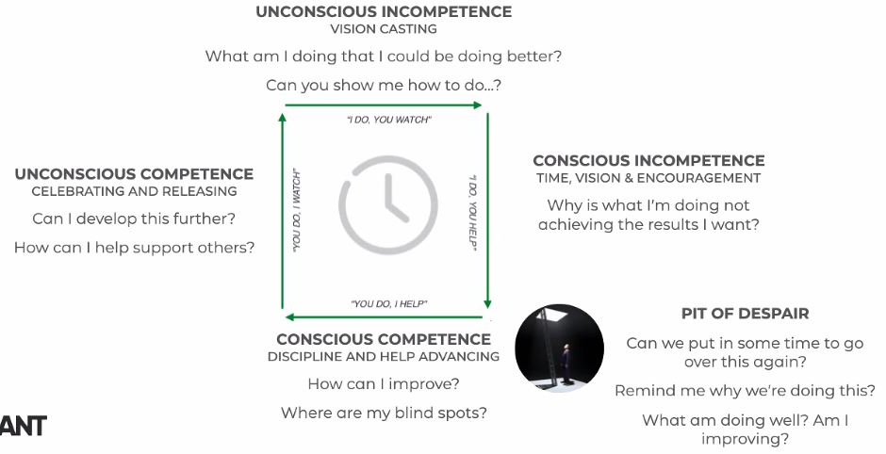
Starting out

Slide 7
Expectations
Notes:
Impossible and Unrealistic expectations create Dominating cultures and lead to burnout, apathy, resistance, or turnover. Limited and Resigned expectations create Protecting cultures and lead to underperforming, entitled, and unhealthy cultures. Realistic expectations are empowering and the key to leading and communicating effectively.

Slide 8
Expectations
What are you going to do about it?
Notes:
Impossible and Unrealistic expectations create Dominating cultures and lead to burnout, apathy, resistance, or turnover. Limited and Resigned expectations create Protecting cultures and lead to underperforming, entitled, and unhealthy cultures. Realistic expectations are empowering and the key to leading and communicating effectively.

Slide 9
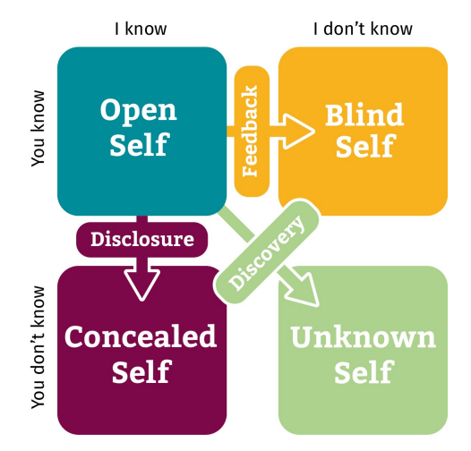
Where are we working?

Slide 10
Where are we working?
Open Self: What I know about myself and you also know
Concealed Self: What I know about myself and you don’t know
Blind Self: What I don’t know about myself, but you do
Unknown Self: What I don’t know about myself, and you don’t know

