Slide 1
to enable you to become the ordained minister that God is calling you to become in the Church of England
to provide the best possible training and support, fostering good patterns and practices, and helping you to inform and develop your understanding of mission and ministry
to assist in the development of your skills and competencies for undertaking a post of primary responsibility or an assistant clergy post (under the formation framework)
What is a Curacy?

Slide 2
to encourage you in ongoing reflection, to relate your parochial, contextual experience to the whole of your ministerial formation,
to encourage you to take risks, try things, and to broaden possible horizons for ministry in a safe and supportive space
to nurture reflective, flexible and collaborative Deacons and Priests for ministry for now and for the years to come.
What is a Curacy?

Slide 4
Starting Well

Slide 5
Starting Well:
What’s Changed
Expectations
Your Role
Notes:
And also, appendix-20 and 21

Slide 6
Starting Well:
What’s Changed
Expectations
Your Role
Notes:
When did you first have conversations?
What was parish, ministry, team, people, culture like then, what’s it like now?
Discuss with next neighbour- what has changed,

Slide 7
Starting Well:
What’s Changed
Expectations
Your Role

Slide 8
What’s Changed
Expectations
Your Role
Notes:
Impossible and Unrealistic expectations create Dominating cultures and lead to burnout, apathy, resistance, or turnover.
Limited and Resigned expectations create Protecting cultures and lead to underperforming, entitled, and unhealthy cultures.
Realistic expectations are empowering and the key to leading and communicating effectively.

Slide 9
What’s Changed
Expectations
Your Role
Notes:
How are you going to be communicating?
Not you to them, or them to you,
----but together communicating, negotiaing, agreeing and ‘contracting’
Agreeing when and how to check in and review
PARISH/ COMMUNITY/ TEAM

Slide 10
Starting Well:
What’s Changed
Expectations
Your Role

Slide 11
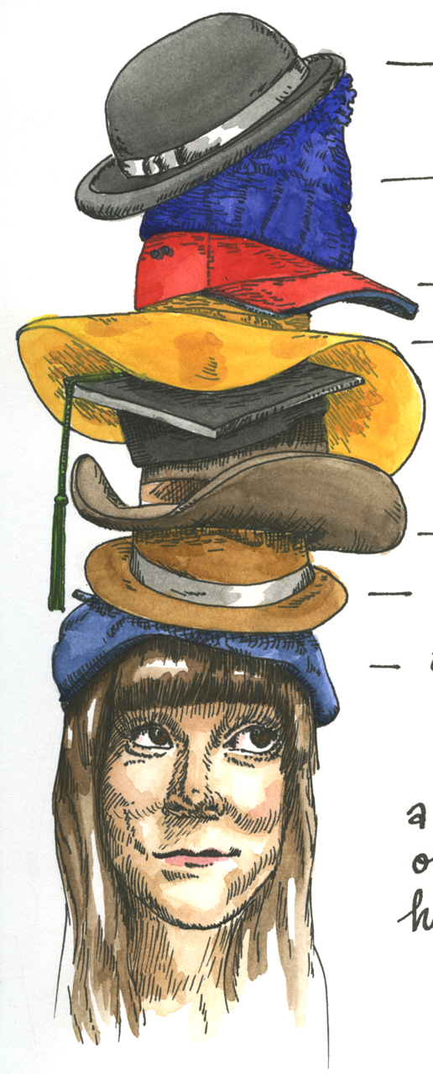
THE ROLE OF
THE TRAINING
INCUMBENT
Notes:
PAGE 5 and 6:
And also, appendix-20 and 21

Slide 12
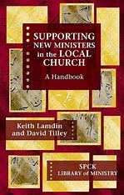
THE ROLE OF THE TRAINING INCUMBENT
Manager
Educator
Mediator
Supporter
Adapted from Keith Lamdin and David Tilley, Supporting New Ministers in the Local Church (SPCK, 2007)

Slide 13
Manager (Steward)
“In the New Testament, apostolic ministry is described as the ordering or stewardship of a household”
• Discuss, agree and review work and goals
• Plan time
• Set boundaries/areas of responsibility
• Monitor progress
• Handle issues of difference and conflict
• Discuss and agree reports

Slide 14
Educator (Teacher)
“The giving and receiving of instruction is a central responsibility of those who oversee the people of God”
• Help the curate with new knowledge, attitudes and behaviour
• Explain how and why things are done
• Enable the curate’s gifts to develop
• Reflect on practice (both curate’s and TI’s)
• Theological Reflection – integrating faith and learning
• Offer feedback, praise and criticism

Slide 15
Mediator (Intercessor)
“Those with supervisory responsibility … have a special responsibility to establish and sustain relationships in God’s name”
• Pray for your curate
• Connect the curate to people, in church community and beyond
• Ensure the curate is well treated (housing, expenses, IME etc.)
• Protect the curate from parish conflicts
• Public support for your curate
• Ensure the curate has time off

Slide 16
Supporter (Pastor)
Supporter (Pastor)
“The prime task of the shepherd is to keep the flock together, to provide for its nurture and safely”
• Help the curate face difficult issues
• Point to blind spots
• Help the curate to analyse what is going on for them
• Affirm the curate’s work
• Enable the curate to express distress
• Help the curate discern future priorities and possibilities in ministry

Slide 17
Notes:
Two curates- think this through again- but communicating / negotiating expectations
Separately and together – model vulnerablitly:- not sure really how this will look:
But practically… any wisdom
check in regularly

Slide 18
What now?
Notes:
What now for you, and what more do you need- from diocese, collegues etc.
Write down, put it in your diary/ calendar/ send your self an email, voice note, etc.
Then assumptions:
-Everyone is different
-Different starting points
-Curacy is for the curate to flourish
-Better than us
-Power
-Joy

Slide 19
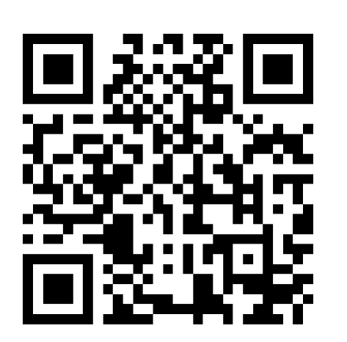
https://forms.office.com/e/x1ewr0uBUb
Feedback Request
Notes:
Open and do over:
Will be emailed too, with yesterday afternoon slides

